Slide 1
SUDOKU GAME NAME : C. Shoushmitha REGISTER NO:192111621

Slide 2
OBJECTIVE :
2
The objective of the Sudoku game is to fill a 9x9 grid with numbers so that each row, each column, and each of the nine 3x3 subgrids (also called “boxes” or “regions”) contains all of the digits from 1 to 9.
The puzzle starts with some cells already filled in, and the player must use logic and deduction to figure out the correct numbers to fill in the remaining empty cells, ensuring that the rules are followed.
The challenge lies in finding the right combination of numbers to complete the grid without violating any of the given conditions

Slide 3
INTRODUCTION: Its simple yet captivating premise involves filling a 9x9 grid with numbers from 1 to 9, ensuring each row, column, and 3x3 subgrid contains all digits without repetition. Beyond entertainment, Sudoku offers mental benefits such as improving concentration, memory, and problem-solving skills. It has fostered a vibrant community of players who share strategies, tips, and their love for the game through various platforms and competitions.

Slide 4
LITERATURE SURVEY:
4
1.“Comparison Analysis of Breadth First Search and Depth Limited Search Algorithms in Sudoku Game”. Tirsa Ninia Lina,Matheus Supriyanto Rumetna The purpose of this research is to find a solution for Sudoku and make a comparative analysis of the search results of the two algorithms.
2.“Sudoku Game Solving Approach Through Parallel Processing” Monika Jain & Syed Mohammad Yaqub The paper also discusses the performance of a serial version solution with respect to execution time taken to solve Sudoku.

Slide 5
LITERATURE SURVEY : 3.“Effects of Two Types of Sudoku Puzzles on Students’ Logical Thinking” Youngkyun Baek1, Bokyeong Kim This study aims to investigate the effects of Sudoku on students’ logical thinking. Specifically, the author wants to measure the effects of playing a number-based Sudoku and a symbol-based version on player’s logical thinking, especially in terms of their cognitive developmental stages 4. “Solving Sudoku game using a hybrid classical-quantum algorithm” Ankur Pal1, Sanghita Chandra1,Vardaan Mongia udoku is a fun combinatorial game, based on the Latin square, which has wide applications as being an efficient design in controlling multiple sources of variable nuisance simultaneously.

Slide 6
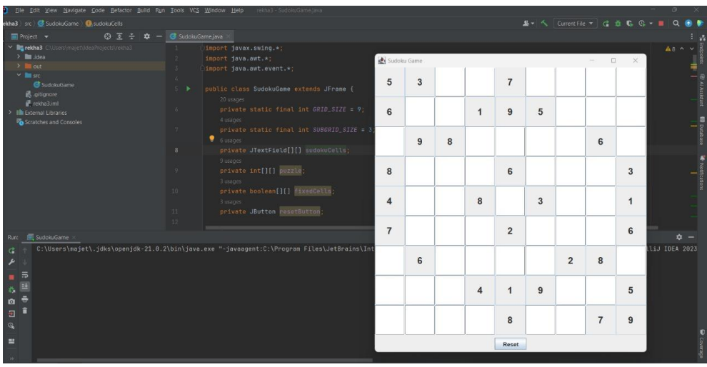
OUTPUT:

Slide 7
CONCLUSION:
In conclusion, Sudoku is a globally cherished puzzle game, originating from Switzerland and gaining widespread popularity in the late 20th century. Offering a captivating blend of simplicity and challenge, it requires logical deduction and strategic thinking to fill a 9x9 grid with numbers from 1 to 9 without repetition.
Its accessibility, endless variations, and mental benefits make it a beloved pastime for players of all ages. Furthermore, Sudoku fosters a vibrant community of enthusiasts who share strategies and tips, ensuring its enduring appeal in the digital age.

Slide 8
Thank You
.

